Slide 1



Formal Verification of Rust Programs by Functional Translation
Son Ho, under the supervision of Jonathan Protzenko, Karthikeyan Bhargavan and Bruno Blanchet
Notes:
Modernizing verification by leveraging Rust

Slide 2

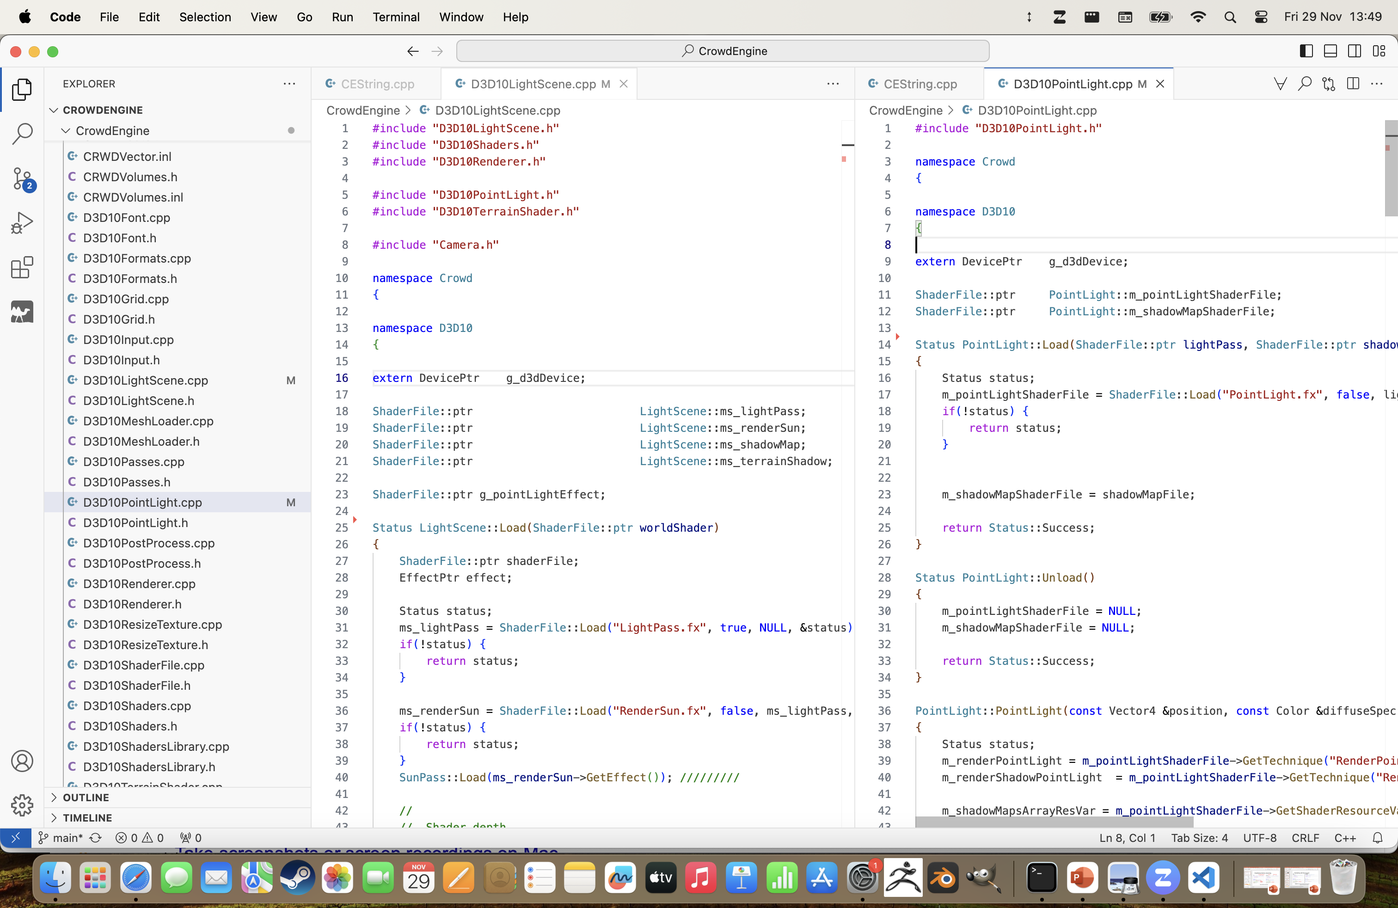
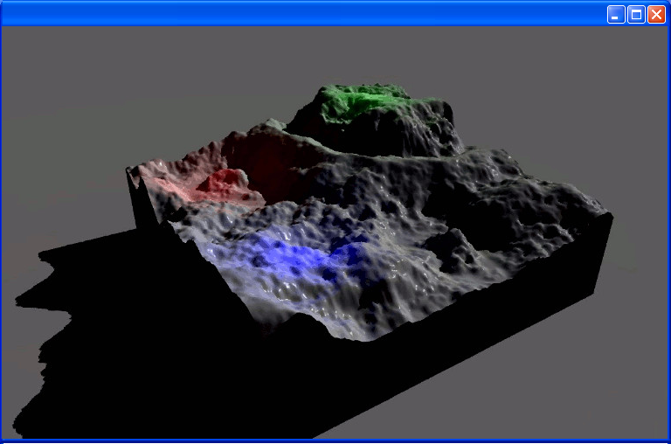
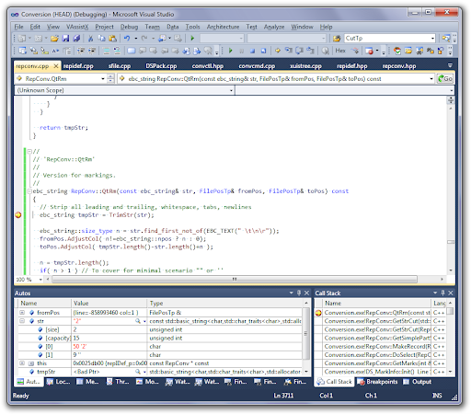
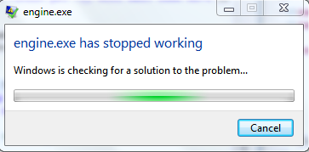
As a High-school Student…
If a program crashes upon exit is it really a problem?...

Slide 3





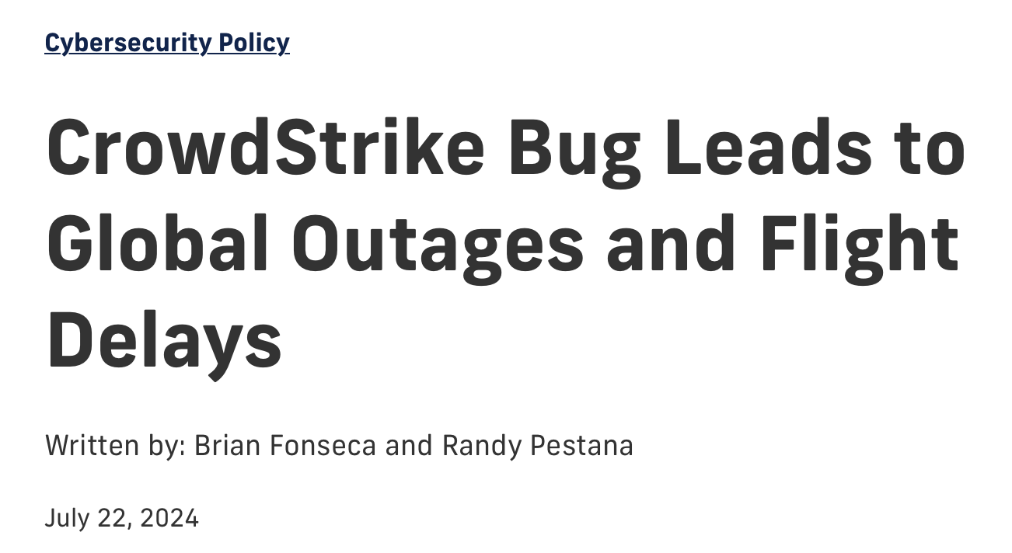
Famous Bugs in the Wild (i)

Slide 4

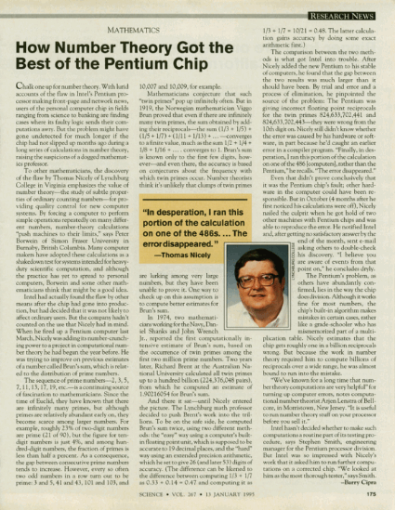


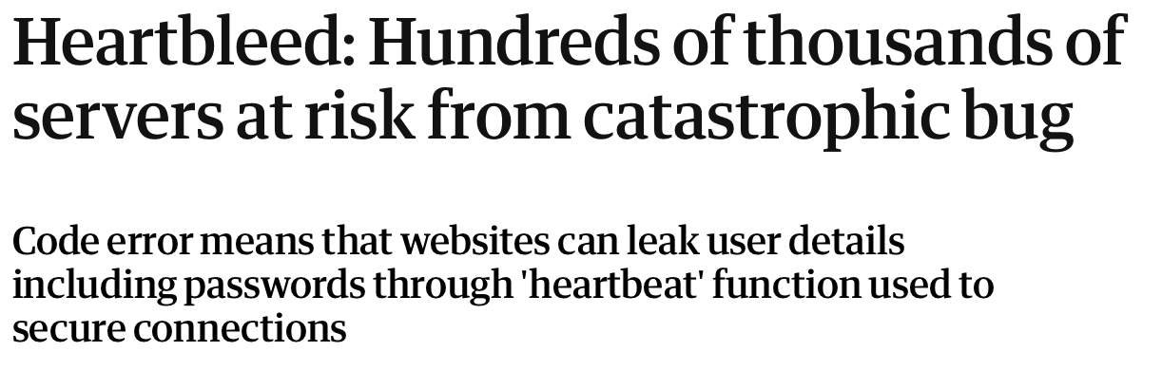


Famous Bugs in the Wild (ii)
Ariane 5
(integer overflow)
Intel Pentium FDIV bug (incorrect floating point division)
Therac 25
(radiation overdose)
Heartbleed
(critical vulnerability in OpenSSL cryptographic library)
“Fatal Radiation Dose in Therapy Attributed to Computer Mistake”
Notes:
Ariane 5: just the satellites = 370M$
Intel Pentium: 470M$
Therac 25: 4 deaths + 2 injuuries
Heartbleed?

Slide 5
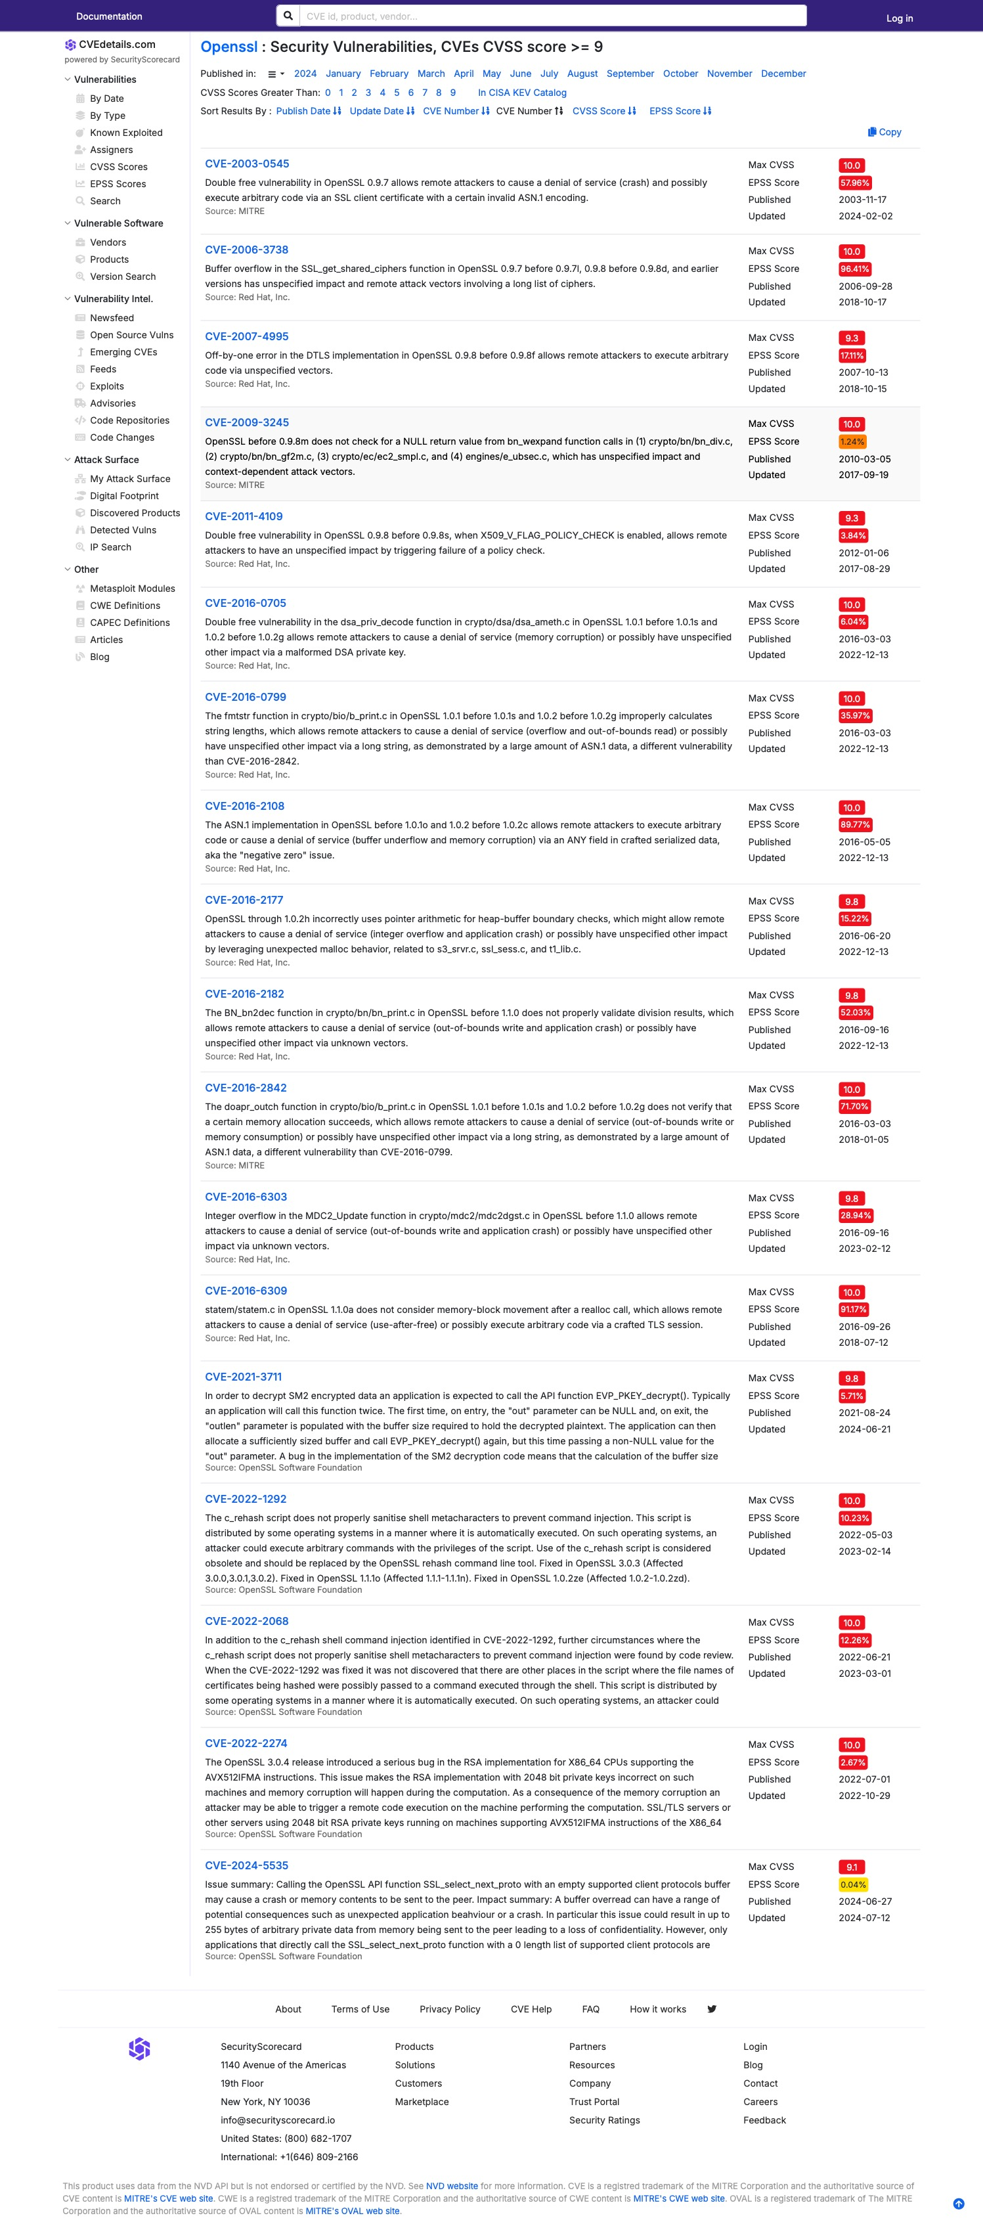
The Unnoticed Bugs of the Week
“On average, there are 15 to 50 defects per 1,000 lines of code in delivered software”, Steve McConnell
Common Vulnerability Exposures in OpenSSL cryptographic library:
How can we develop secure software at scale?
Starting with low-level software (cryptographic implementations, micro-kernels, embededded systems, etc.)?

Slide 6

Main Classes of Vulnerabilities
1. Runtime safety
Does my program run without crashing?
In particular: Memory safety:
Software runs on physical hardware
All data is stored on a physical memory
Properly managing this memory is error-prone
2/3 of vulnerabilities!
Rust: memory safe language without a garbage collector
2. Functional correctness
Does my program do what it should do?
Ex.: optimized implementations, complex state machines, etc.
Program verification?

Slide 7



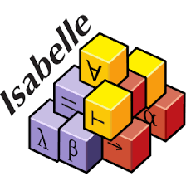




Program Verification
Statically verify that this program is exempt of bugs before even running it?
function divide(x: int, y: int): int
{
x / (y - 1)
}
function divide(x: int, y: int): int
requires y != 1
{
x / (y - 1)
}
Testing, fuzzing, etc. fail to catch all bugs and provide no guarantee
Possible division by zero!
Precondition is not satisfied
result = 2
var result = divide(4, 3);
var result = divide(3, 1);
Astrée
F*
Dafny
Coq
Isabelle
Why3

Slide 8












The Software Verification Landscape
Big verification projects:
CompCert
(optimizing C compiler)
seL4
(micro kernel)
CertIKOS
(micro kernel)
IronFleet
(distributed key-value store)
Hacl*
(cryptographic library)
FiatCrypto
(cryptographic library)
AWS LibCrypto
(cryptographic library)
Cedar
(policy language and authorization engine)
We can verify real-world programs!
And strong empirical guarantees!
Let’s write programs in Rust and verify them!
But verification is labour intensive…
How do we scale?

Slide 9

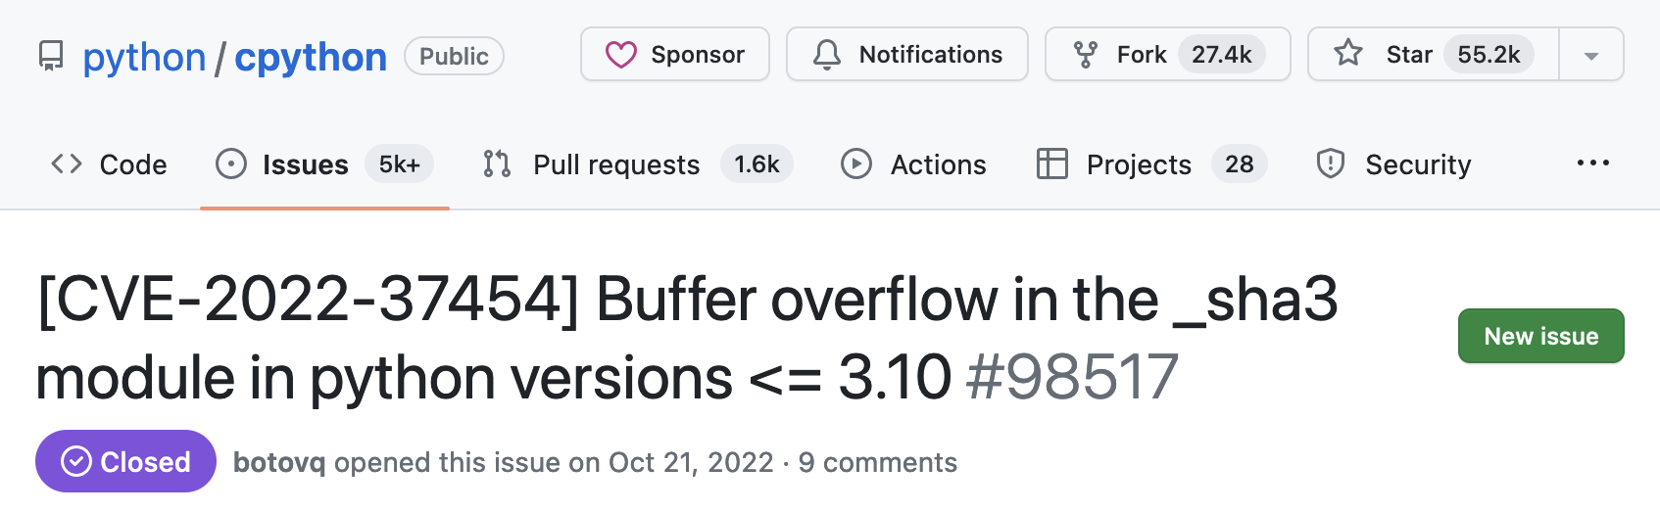
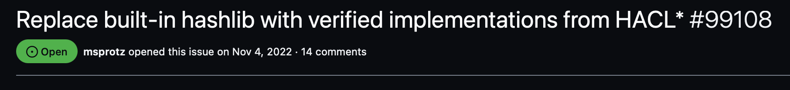
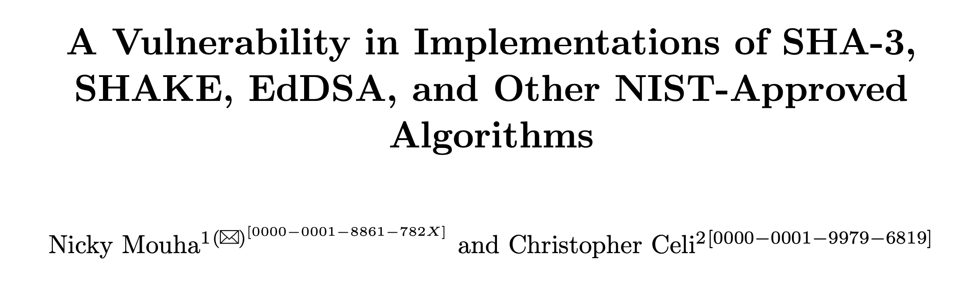
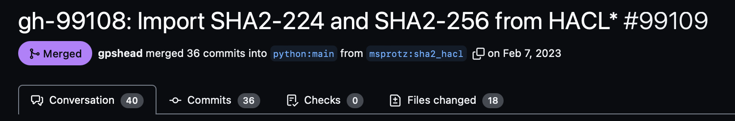
My Verification Journey
Noise* - Verified Protocol Implementations
Streaming Hash Implementations
Noise: family of 59+ protocols (used by WhatsApp, WireGuard, Signal)
IKpsk2:
← s
. . .
→ e, es, s, ss
← e, ee, se, psk
XX:
→ e
← e, ee, s, es
→ s, se
NX:
→ e
← e, ee, s, es
Functional correctness (Low*)
Security proofs (DY*)
Noise*
Verified implementations of streaming hash APIs in F*
Use lightweight DSL to generate zero-cost encoding
45k LoCs
Verify an interpreter once, specialize and partially evaluate
We can verify real-world cryptographic implementations!
Specialized, performant C code
High-level API (peer, session management, …)
4k-6k LoCs per protocol

Slide 10
Towards Secure Systems at Scale
Is the problem solved?
Can we move beyond cryptography?
Not that simple…
2 big challenges:
Reasoning about memory and aliasing is tedious (problem is not just safety)
There is no one size fits all proof automation
The main contribution of this thesis
New toolchain:
Aeneas toolchain

Slide 11
Problem 1: Reasoning about Memory (i)
Exclusive access
(non-null, non-dangling, disjoint)
In C:
In Rust:
Null? Dangling? Aliased?
Lifetime ‘a
uint32_t *choose(bool b, int32_t *x, int32_t *y)
{
if b { return x; }
else { return y; }
}
uint32_t *choose(bool b, int32_t *x, int32_t *y)
{
if b { return x; }
else { return y; }
}
fn choose<'a>(b : bool, x : &'a mut i32, y : &'a mut i32)
-> &'a mut i32
{
if b { return x; }
else { return y; }
}
fn choose<'a>(b : bool, x : &'a mut i32, y : &'a mut i32)
-> &'a mut i32
{
if b { return x; }
else { return y; }
}
fn choose<'a>(b : bool, x : &'a mut i32, y : &'a mut i32)
-> &'a mut i32
{
if b { return x; }
else { return y; }
}
In Low*:
live h x ∧ live h y ∧
disjoint x y
uint32_t x = 0;
uint32_t y = 1;
uint32_t *z = choose(true, &x, &y);
*z = 2; // Updates x
// Observe the changes
assert(x == 2);
assert(y == 1);
uint32_t x = 0;
uint32_t y = 1;
uint32_t *z = choose(true, &x, &y);
*z = 2; // Updates x
// Observe the changes
assert(x == 2);
assert(y == 1);
let mut x = 0;
let mut y = 1;
let z = choose(true, &mut x, &mut y);
*z = 2; // Updates x
// Observe the changes
assert!(x == 2);
assert!(y == 1);
Null? Dangling? Aliasing?
z live?
z live!
‘a
Dynamic frames
Separation logic
…
x changed
y didn’t
Statically inferred by borrow-checker
Rust gives memory safety…
and enforces a strict control of aliasing!

Slide 12
Design choice 1: Take advantage of Rust to simplify memory reasoning

Slide 13


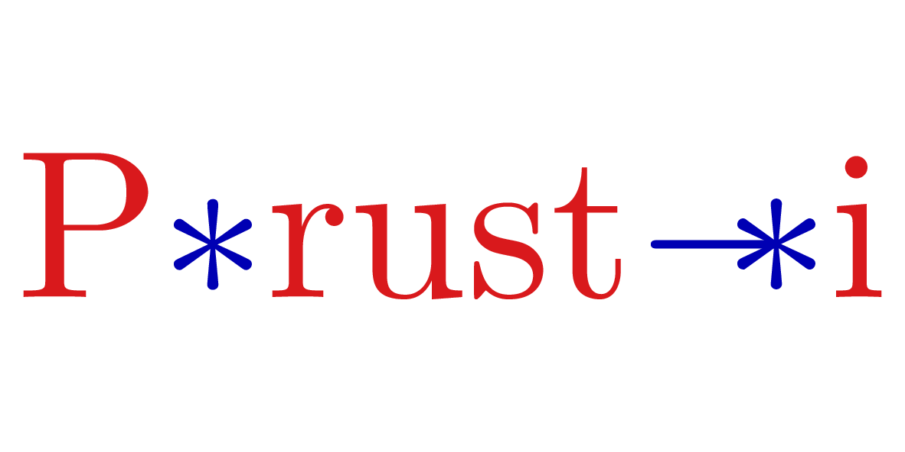
Simplify Reasoning with Safe Rust
Existing verification tools targeting safe Rust:
Guide memory reasoning:
Abstract away memory reasoning:
Electrolysis
Creusot
Verus
Automation based on Satisfiability Modulo Theory (SMT) solvers
Interactive Theorem Provers (Lean 3)

Slide 14

Problem 2: SMT-based verification
let aead_encrypt :
(key:lbuffer uint8 32ul)
...
(input:lbuffer uint8 len)
(output:lbuffer uint8 len)
(tag:lbuffer uint8 16ul) :
Stack unit
(requires (fun h0 ->
live h0 key /\ live h0 nonce /\ … /\
disjoint key output /\ disjoint nonce output /\ … ))
(ensures (fun h0 _ h1 -> modifies2 output tag h0 h1 /\ ...) =
let ctx = chaha20_create_state () in
chacha20_init ctx key n ctr;
chacha20_update ctx len cipher input;
chacha20_encrypt mlen cipher m k n 1ul;
let tmp = create 64ul (u8 0) in
chacha20_encrypt #w 64ul tmp tmp k n 0ul;
let key = sub tmp 0ul 32ul in
poly1305_do #w key aadlen aad mlen cipher mac
let aead_encrypt :
(key:lbuffer uint8 32ul)
...
(input:lbuffer uint8 len)
(output:lbuffer uint8 len)
(tag:lbuffer uint8 16ul) :
Stack unit
(requires (fun h0 ->
live h0 key /\ live h0 nonce /\ … /\
disjoint key output /\ disjoint nonce output /\ … ))
(ensures (fun h0 _ h1 -> modifies2 output tag h0 h1 /\ ...) =
let h0 = ST.get ();
let ctx = chaha20_create_state () in
let h1 = ST.get ();
assert (to_v h1 ctx == Spec.chacha20_create ...);
chacha20_init ctx key n ctr;
chacha20_update ctx len cipher input;
chacha20_encrypt mlen cipher m k n 1ul;
let tmp = create 64ul (u8 0) in
chacha20_encrypt #w 64ul tmp tmp k n 0ul;
let key = sub tmp 0ul 32ul in
poly1305_do #w key aadlen aad mlen cipher mac
let aead_encrypt :
(key:lbuffer uint8 32ul)
...
(input:lbuffer uint8 len)
(output:lbuffer uint8 len)
(tag:lbuffer uint8 16ul) :
Stack unit
(requires (fun h0 ->
live h0 key /\ live h0 nonce /\ … /\
disjoint key output /\ disjoint nonce output /\ … ))
(ensures (fun h0 _ h1 -> modifies2 output tag h0 h1 /\ ...) =
let h0 = ST.get ();
let ctx = chaha20_create_state () in
let h1 = ST.get ();
assert (to_v h1 ctx == Spec.chacha20_create ...);
chacha20_init ctx key n ctr;
let h2 = ST.get ();
assert (to_v h2 ctx == Spec.chacha20_init ...);
chacha20_update ctx len cipher input;
chacha20_encrypt mlen cipher m k n 1ul;
let tmp = create 64ul (u8 0) in
chacha20_encrypt #w 64ul tmp tmp k n 0ul;
let key = sub tmp 0ul 32ul in
poly1305_do #w key aadlen aad mlen cipher mac
let aead_encrypt :
(key:lbuffer uint8 32ul)
...
(input:lbuffer uint8 len)
(output:lbuffer uint8 len)
(tag:lbuffer uint8 16ul) :
Stack unit
(requires (fun h0 ->
live h0 key /\ live h0 nonce /\ … /\
disjoint key output /\ disjoint nonce output /\ … ))
(ensures (fun h0 _ h1 -> modifies2 output tag h0 h1 /\ ...) =
let h0 = ST.get ();
let ctx = chaha20_create_state () in
let h1 = ST.get ();
assert (to_v h1 ctx == Spec.chacha20_create ...);
chacha20_init ctx key n ctr;
let h2 = ST.get ();
assert (to_v h2 ctx == Spec.chacha20_init ...);
chacha20_update ctx len cipher input;
let h3 = ST.get ();
assert (to_v h3 cipher == Spec.chacha20_update ...);
chacha20_encrypt mlen cipher m k n 1ul;
let tmp = create 64ul (u8 0) in
chacha20_encrypt #w 64ul tmp tmp k n 0ul;
let key = sub tmp 0ul 32ul in
poly1305_do #w key aadlen aad mlen cipher mac
let aead_encrypt :
(key:lbuffer uint8 32ul)
...
(input:lbuffer uint8 len)
(output:lbuffer uint8 len)
(tag:lbuffer uint8 16ul) :
Stack unit
(requires (fun h0 ->
live h0 key /\ live h0 nonce /\ … /\
disjoint key output /\ disjoint nonce output /\ … ))
(ensures (fun h0 _ h1 -> modifies2 output tag h0 h1 /\ ...) =
let h0 = ST.get ();
let ctx = chaha20_create_state () in
let h1 = ST.get ();
assert (to_v h1 ctx == Spec.chacha20_create ...);
chacha20_init ctx key n ctr;
let h2 = ST.get ();
assert (to_v h2 ctx == Spec.chacha20_init ...);
chacha20_update ctx len cipher input;
let h3 = ST.get ();
assert (to_v h3 cipher == Spec.chacha20_update ...);
chacha20_encrypt mlen cipher m k n 1ul;
let h4 = ST.get ();
assert (as_seq h4 cipher == Spec.chacha20_encrypt_bytes ...);
let tmp = create 64ul (u8 0) in
chacha20_encrypt #w 64ul tmp tmp k n 0ul;
let key = sub tmp 0ul 32ul in
poly1305_do #w key aadlen aad mlen cipher mac
Proofs become unstable:
#push-options "--z3cliopt smt.arith.nl=false"
#push-options "--using_facts_from '*,-Seq.slice_slice'"
Formal pre/postconditions
key : lbuffer uint8 32ul
...
input : lbuffer uint8 len
output: lbuffer uint8 len
tag : lbuffer uint8 16ul
ctx : state
h0 : mem
h1 : mem
to_v h1 ctx == Spec.chacha20_create ...
...
Always need more automation (ex.: seq., non-linear arith.):
key : lbuffer uint8 32ul
...
input : lbuffer uint8 len
output: lbuffer uint8 len
tag : lbuffer uint8 16ul
ctx : state
h0 : mem
h1 : mem
to_v h1 ctx == Spec.chacha20_create ...
h2 : mem
to_v h2 ctx == Spec.chacha20_init ...
...
key : lbuffer uint8 32ul
...
input : lbuffer uint8 len
output: lbuffer uint8 len
tag : lbuffer uint8 16ul
ctx : state
h0 : mem
h1 : mem
to_v h1 ctx == Spec.chacha20_create ...
h2 : mem
to_v h2 ctx == Spec.chacha20_init ...
h3 : mem
to_v h3 ctx == Spec.chacha20_update ...
...
assert (S.append blocks blocks’ == blocks'');
calc (S.equal) {
S.append blocks blocks';
(S.equal) { (* rest = S.empty *) }
S.append (S.append blocks rest) blocks';
(S.equal) { }
S.append b blocks';
(S.equal) { }
S.append b (fst (split_at_last c i d));
(S.equal) { (* definition of split_at_last *) }
S.append b (fst (S.split d ((S.length d / l) * l)));
(S.equal) { (* definition of split *) }
S.append b (S.slice d 0 ((S.length d / l) * l));
(S.equal) { }
S.slice (S.append b d) 0 (S.length b + (S.length d / l) * l);
(S.equal) { Math.Lemmas.div_exact_r (S.length b) l }
...
(S.equal) { }
blocks'';
}
“Unknown assertion failed”
Proof obligations sent to Z3 SMT solver
Notes:
https://github.com/hacl-star/hacl-star/blob/main/code/streaming/Hacl.Streaming.Functor.fst#L268-L368 this is supposed to be automated, but look at the amount of manual reasoning! I might as well be in an interactive theorem prover, my life would be easier
look at the commit history for that file (git log --follow -u Hacl.Streaming.Functor.fst or just go to https://github.com/hacl-star/hacl-star/commits/main/code/streaming/Hacl.Streaming.Functor.fst), in particular these commits https://github.com/hacl-star/hacl-star/commit/4ee8f50a9c0a8da08df5dc5c6af488b8420badcd this one is entirely about working around the limitations of the SMT, factoring out helper proofs and definitions and disabling non-linear arithmetic because proofs were too unstable
https://github.com/hacl-star/hacl-star/commit/0b16475cc6278aac2b1410b3ddafc73ac6f0438b look at my comments here
memory reasoning doesn't work with SMT: https://github.com/hacl-star/hacl-star/commit/6b068a67577bed5f4aed7aa98f5c0bed350fdc28 and https://github.com/hacl-star/hacl-star/commit/6b068a67577bed5f4aed7aa98f5c0bed350fdc28 https://github.com/hacl-star/hacl-star/commit/93660b88fc0645abf06900a77b003e4c879b400e
https://github.com/hacl-star/hacl-star/commit/98e8910670b0a63786479f0dcf56100081f991b8 "try restarting the solver for more determinism"
"kill the last flaky proof" https://github.com/hacl-star/hacl-star/commit/4e89581d7a0d6313534de0c7ed063dd5639c6766
"rewrite the lemma in a form that doesn't cause as many problems" https://github.com/hacl-star/hacl-star/commit/072d7d78e28c591bea27280532f75b1e4b15cbc9
5:42
https://github.com/hacl-star/hacl-star/pull/914/files
5:42
https://github.com/hacl-star/hacl-star/pull/845/files

Slide 15
Design choice 2: Custom, extensible automation with interactive theorem provers

Slide 16
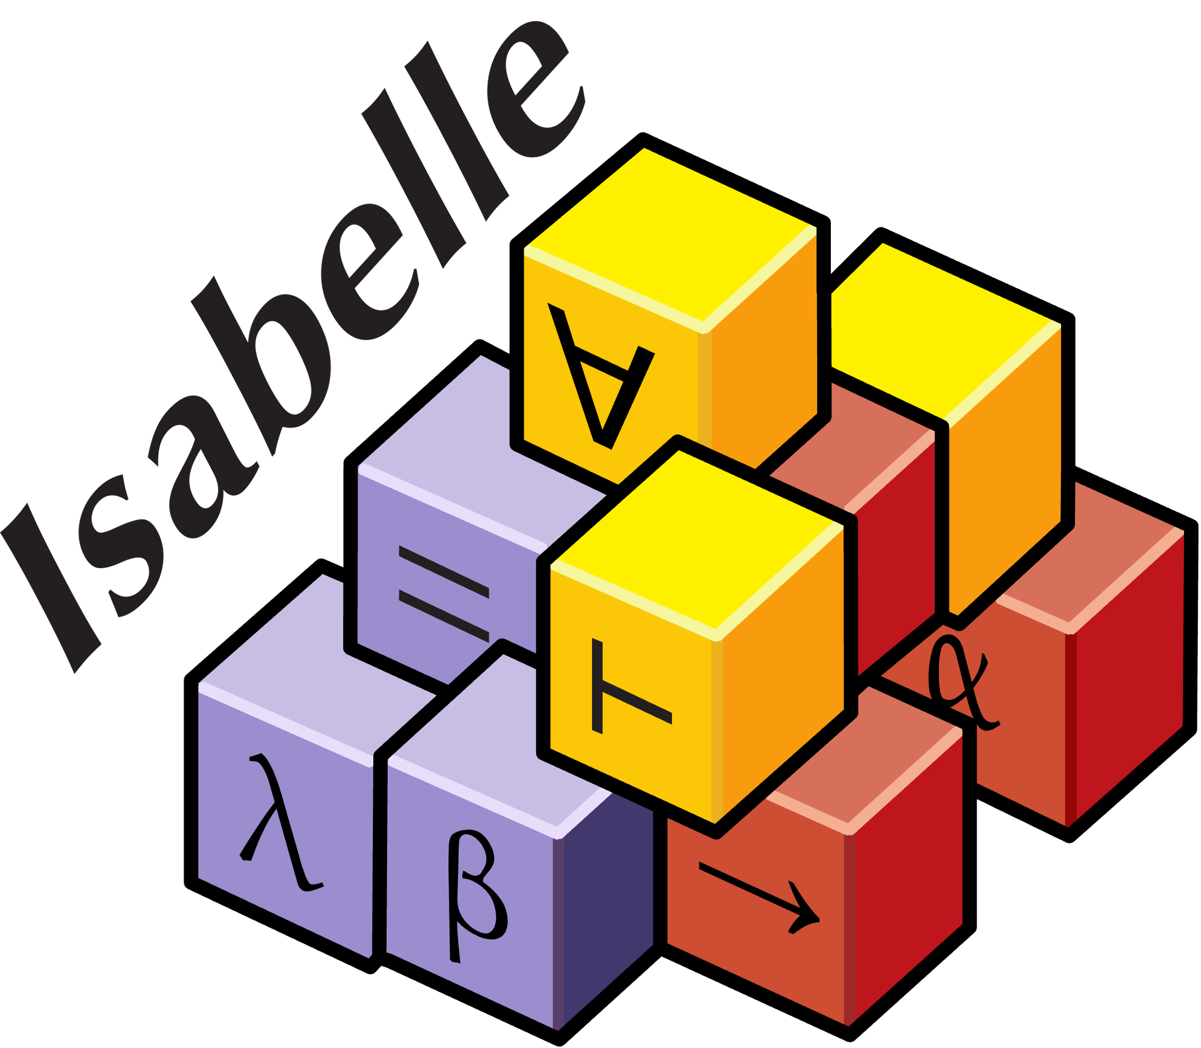
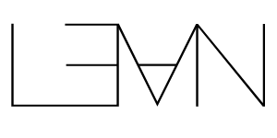
Infrastructure
Design choice 1:
No memory reasoning
Charon
Aeneas
Aeneas
λ-Calculus
HOL4
Safe Rust
LLBC
Pure model
No need for live h x, disjoint x y, etc.!
Focus on functional correctness
. . .
Great user interface
Dynamic community
Powerful meta-programming
Design choice 2:
Custom automation with ITPs
Notes:
Remark: insist on the fact that Aeneas is just a compiler and not a verification framework: we target something more general than that.
=====
We implemented this translation and our framework has the following architecture.
We consume MIR (Rust’s Mid-Level IR). Because of the way the Rust compiler is designed, if we want to retrieve its output we have to write a driver in Rust for this Rust compiler, and in our case this driver is called Charon. Because it is simpler to implement an maintain a compiler in a functional language like OCaml, all what Charon does is retrieve the output of the Rust compilation (MIR), convert it to an easy to use AST called LLBC, and finally serialize it.
Then comes the compiler itself, called Aeneas, which deserializes the output of Charon, performs the translation and extracts it in the backend of your choice.
In practice, Charon gives an easy access to the Rust compiler, which is quite complex and very unstable, and should be reusable for other projects. On our side we would be very interested in using it to connect Aeneas to a separation logic framework for unsafe Rust code.
As of today we only have an F* backend, because we are originally F* experts, but we have other backends in the making for Coq, HOL4 and Lean.
The translation itself works by doing some sort of a symbolic execution. Something important to mention is that, in order to make this translation work, we need for every function to compute its borrow graph (that is to say we need to compute who borrows what from whom) at every point of execution. This implies two things:
first, because we compute this borrow graph and check that the borrows are correctly used, we don’t need to trust the borrow checker
second, along the way to designing a mechanism to compute this borrow graph, we came up with an operational semantics for Rust and its borrow mechanism, and this is one of the contributions of our work
Of course, this is still early work and our translation has some limitations, the main ones are the following:
We only target safe Rust for obvious reasons
We have no traits yet, but we believe this to be mostly an engineering problem and that actually it should lead to a very natural executable translation
We have no loops, but are making quite good progress on this
We have no interior mutability because it introduces real aliasing and effects, we would like to have it in the longer term for instance to model coarse grain concurrency
At this point it is important to step back a bit mention that Aeneas is not a verification framework in itself: you don’t give it a program, push a button and receive an answer such as “yes everything is fine” or “no there is a problem”. It should really be seen as a generic pipeline: you give it as input a safe Rust program, it compiles it to a pure model and that’s all. Then, once you have this pure model can do whatever you want with this it, for instance you can extract it to Lean (once the backend is done) and for instance, prove that the program is panic free and functionally correct under the proper assumptions. But you may wish to use other frameworks or techniques, and functional correctness and panic freedom are not always what you really want, and that’s fine you can do other things: for instance, if you apply it to a cryptographic protocol, you can also prove security properties about this protocol implementation (this is something we have successfully done in the past in F*, for example quite recently on a project called Noise*, and that we intend to do again on other projects). Also, for now we don’t provide a way of writing annotations on the input program, because we want to focus on extrinsic proofs and also because adding an annotation language is a lot of engineering work, but we would be interested in supporting such annotation language in the future: we could then generate lemma statements in addition to the pure model.
The project is of course publicly available on github, we presented the work at ICFP last month and there is a long, detailed version available online, and if you have specific questions please feel free to contact us.

Slide 17
Translating Safe Rust to Pure
Rust:
Translation (automatically generated):
fn choose<'a>(
b : bool, x : &'a mut i32, y : &'a mut i32)
-> &'a mut i32
{
if b { return x; }
else { return y; }
}
let choose (b : bool) (x : i32) (y : i32) : i32 =
if b then x else y
let choose (b : bool) (x : i32) (y : i32) :
i32 * (i32 -> i32 * i32) =
if b then
(x, fun z -> (z, y))
else
(y, fun z -> (x, z))
let mut x = 0;
let mut y = 1;
let z = choose(true, &mut x, &mut y);
*z = 2; // Update x
// Observe the changes
assert!(x == 2);
assert!(y == 1);
...
let x = 0 in
let y = 1 in
let z = choose true x y in
...
let x = 0 in
let y = 1 in
let z = choose true x y in
let z = 2 in
...
let x = 0 in
let y = 1 in
let z = choose true x y in
let z = 2 in
let (x, y) = ?? in
...
let x = 0 in
let y = 1 in
let z = choose true x y in
let z = 2 in
let (x, y) = (z, y) in
...
let x = 0 in
let y = 1 in
let z = choose true x y in
let z = 2 in
let (x, y) = if true then (z, y) else (x, z) in
...
let x = 0 in
let y = 1 in
let (z, choose_back) = choose true x y in
let z = 2 in
let (x, y) = choose_back z in
...
‘a ends here
?
Modular (type-driven) translation with forward and backward functions
Support for large subset of Rust (traits, loops), idiomatic models
Notes:
Let’s go back to the choose example I introduced before, and let’s do the translation step by step.
The beginning is very simple: we initialize x with 0 and y with 1, and then call choose which gives us some value z which we compute by calling this “purified” version of choose, which is the same as the original Rust function but without borrows because borrows don’t make sense in the pure world.
Next we have to translate this in-place update `*z = 2`. This updates x in place, but because z gives us a view about x and y (as we don’t have access to x and y for as long as z lives), we don’t have to update x and y yet. All we have to do is take into account the fact that z gives us access to some value, and that from now onwards this value is equal to 2. So we simply translate this to `let z = 2 in` and continue.
Now comes the interesting part: we have to end the ‘a lifetime which gives us access back to x and y. The important point is that we made an in-place update here, through z, but it is only upon ending this ‘a lifetime that we observe the effect of doing this in-place modification, by retrieving access back to x and y. As a consequence, what we say is that we retrieve new values for x and y. Now what are those new values? It’s actually pretty simple.
Because the boolean was true, choose returned the borrow to x, which means that through z we updated x. So the new value for x is the last value for z, and y is left unchanged. But this is the case only because the boolean was true, if it were false it would be the opposite: x would be left unchanged and y would be updated with the last value for z. And we can thus rewrite the rhs expression this way.
Now we see a pattern appear. Upon calling choose (in the Rust code), we have to compute the values of the outputs returned by choose from the inputs. This is what this purified version of choose does, by computing outputs from the inputs. Then, upon ending the lifetime ‘a, we have to go the other way around, by propagating the effects of the in-place updates back to the inputs. In a sense here we do a forward computation, and there we do a backward computation.
If we rewrite things a bit more, we get the following: when we call choose in the Rust snippet of code, we introduce a call to this choose_fwd function, which is the “purified” version of choose we introduced before. Then, upon ending the lifetime ‘a, we introduce a call to this choose_back function, which takes the value z and propagates it backward, back to the inputs, and its body is just what we had there before.
This is the whole idea of the translation: whenever we need to translate a Rust function, we generate one forward function, which is used at call-site, and a set of backward functions, one per lifetime appearing in the signature, and which are used to propagate updates back into the environment, whenever we end a lifetime. Those forward and backward functions are actually very similar to lenses (with the get and put_back functions), and lead to an executable translation which is quite idiomatic: just to give you a more interesting example, if you write a function which gives you a mutable access to the nth element of a list, in our translation the forward function is simply a “get the nth element” function, and the backward function is “update the nth element” by reinserting the given back value back where it belongs. And we get similar translations for all the functions manipulating tree-like data-structures (which is the kind of data-structures safe Rust allows you to write).
Something very interesting about this translation is that it is modular: to be more precise, in order to generate the snippet of code on the write, we only need to look at the signature of choose, we don’t need to know its body which could be treated as opaque. To be more precise: the number of backward functions, and the types of the forward and backward functions, can be derived by looking only at the signature of the original Rust function.
In the case of the forward functions it is pretty simple: we “purify” the types by removing the borrows basically.
In the case of the backward functions: the function takes the same inputs as the forward function, which we need for the control-flow or to remember the old values of x and y, and takes as additional inputs the values borrowed through the output, and which we need to propagate backward upon ending the lifetime ‘a. In the case of choose, we return one mutable borrow of type i32, so the backward function needs to propagate one value of type i32.
Then, we need to return new values for all the borrows we consumed: here we have two input borrows x and y, so we simply return a pair of the appropriate types.
What we see here is that the signature of a function in Rust (in the subset we consider) fully captures the effectful behavior of this function, because in the pure world we can then characterize a call to this function by calls to forward and backward functions of the proper types. The types of those functions give as the effectful behavior, and their bodies give us the functional behavior.
In practice, this modularity is extremely useful:
To actually perform the translation
To handle external dependencies: whenever we compile a crate and find external functions, we don’t need to dive into those functions: we can treat them as opaque definitions and limit ourselves to looking at their signature. In the generated code, we generate declarations of the proper forward and backward functions, and we leave it up to the user to provide models for those functions, either by writing an implementation or providing lemmas
We believe it will be useful to handle traits and function pointers (which we just need to treat as opaque functions) in a systematic and modular way

Slide 18
How does the translation work?
Aeneas
λ-Calculus
HOL4
Safe Rust
Pure model
Pure model
Where do we introduce the calls to the backward functions?
What do they receive as inputs/give us back as outputs?
. . .
⟹ We need to precisely track the “borrow graph”

Slide 19
How Does the Translation Work?
Aeneas
Safe Rust
Pure model
LLBC
?
Symbolic Execution
How to track borrows in the presence of opaque function calls?
How do we encode lifetime constraints?
How to track borrows at all in the first place?

Slide 20
The Low-Level Borrow Calculus
LLBC: operational semantics for Rust (MIR) which abstracts the memory
Low-Level Borrow Calculus (LLBC):
let mut x = 0;
let p = &mut x;
*p = 1;
assert!(x == 1);
x -> 0
let mut x = 0;
let p = &mut x;
*p = 1;
assert!(x == 1);
let mut x = 0;
let p = &mut x;
*p = 1;
assert!(x == 1);
x -> 0
p -> ?
x -> ?
p -> mut_borrow .. 0
x -> mut_loan l₀
p -> mut_borrow l₀ 0
x -> mut_loan l₀
p -> mut_borrow l₀ 0
x -> mut_loan l₀
p -> mut_borrow l₀ 0
x -> mut_loan l₀
p -> mut_borrow l₀ 0
x -> mut_loan l₀
p -> mut_borrow l₀ 0
x -> mut_loan l₀
p -> mut_borrow l₀ 1
x -> mut_loan l₀
p -> mut_borrow l₀ 1
x -> mut_loan l₀
p -> mut_borrow l₀ 1
x -> mut_loan l₀
p -> mut_borrow l₀ 1
x -> mut_loan l₀
p -> mut_borrow l₀ 1
x -> 1
p -> ⊥
x -> 1
p -> ⊥
let z = choose(true, &mut x, &mut y);
push/pop stack
⟹ (Lazy) operational semantics which captures the essence of Rust borrows
Notes:
If you want to be extremely precise: we introduce an operational semantics for a large subset of safe Rust, which doesn't include features like interior mutability (I think we can argue that LLBC does work in the presence of interior mutability, but I don't want to claim anything before thinking more about it).
Our translation is based on a symbolic execution, during which we compute the borrow graph (who borrows what from whom) at every point of execution in a function under translation.
The first ingredient we needed to design this symbolic execution was an operational semantics for safe Rust and its borrow mechanism. This is a contribution on its own and can be reused independently (for instance, Ilya's paper Leveraging Rust Types for Program Synthesis reused the idea of using loans/borrows from Aeneas – they call their adaptation "blocking sets"). For example, in the choose example: we end the borrow z exactly at the moment we need to get access back to x or y (because z borrows those two values).
The difficult part is to properly abstract function calls: we do this with a device we call "region abstractions". Importantly, those are introduced by looking only at the function signatures, hence the modularity of the extraction.
In effect, by doing this we get a borrow checker, which means we don't need to trust the Rust borrow checker.
In practice, we also note that our borrow checker is quite precise: we manage to feed Aeneas with some examples which are accepted only with Polonius (if they ask: there is an example with map which is used by Niko Matsakis to explain the typical limitations of the current borrow checker).
Small remark, following JH's "concern": if the lifetime inference changes, the generated functions change (the backward functions are inserted in different places). This is not an issue, because the resulting functions are all equivalent.

Slide 21
Abstracting Function Calls: Symbolic Execution
Function signatures can be used as summaries to abstract function calls:
fn choose<'a>(b : bool, x : &'a mut i32, y : &'a mut i32) -> &'a mut i32
⟹ If modify LLBC to abstract function calls: symbolic semantics
... let z = choose(true, move px, move py);
...
assert!(x == 2);
assert!(y == 1);
Link input/output borrows through a region abstraction
Invalidate z
Given the trace of a symbolic execution, straightforward to generate a pure model
Conditional branchings and loops: join operation and fixed-point computations
Symbolic execution defines a borrow checker!

Slide 22
Sound Symbolic Borrow-Checking
Symbolic execution defines a borrow checker:
fn insert_in_list(key: Key, value: T,
mut ls: &mut AList<T>) -> bool {
...
}
fn insert_no_resize(&mut self, key: Key,
value: T) {
...
}
fn insert(&mut self, key: Key, value: T) {
...
}
fn new_with_capacity(
capacity: usize,
max_dividend: usize,
max_divisor: usize,
) -> Self {
...
}
pub fn new() -> Self {
...
}
fn clear(&mut self) {
...
}
fn len(&self) -> usize {
...
}
fn contains_key(&self, key: &Key) -> bool {
...
}
Modular analysis (similar to type-checking)
Theorem:
If successfully symbolically execute each function in program 𝒫 individually then:
𝒫 is (memory) safe to execute for a “standard” Pointer Language (PL) which explicitly models memory
LLBC and PL are in bisimulation
Novel proof technique relying on “hybrid states”
⇒ Aeneas is the only formalized borrow-checker for Rust

Slide 23
Backends, Use Cases
What about verifying a data-structure with non-trivial pointer manipulations?
Ex.: a resizing hashtable?
Some needed features:
Models for the standard library
Support for non-structurally terminating recursive functions (F*: decreases clauses)
Support for partial functions (HOL4, Lean: custom elaboration and encoding relying on Tarski fixed-point theorem)
Custom automation: progress, scalar_tac
Implemented libraries, tactics, custom elaboration and proof of hashtable for:
HOL4

Slide 24
Hashtable (i)
pub fn insert(&mut self, key: Key, value: T) {
self.insert_no_resize(key, value);
if self.len() > self.max_load && !self.saturated {
self.resize()
}
}
Source code size: 222 LoCs
def HashMap.insert {T : Type} (self : HashMap T) (key : Usize) (value : T) : Result (HashMap T) := do
let self1 ← HashMap.insert_no_resize self key value
let i ← HashMap.len self1
if i > self1.max_load
then if self1.saturated
then ok self1
else resize self1
else ok self1
Model size: 336 LoCs

Slide 25
Hashtable (ii)
theorem insert_spec {α} (hm : HashMap α) (key : Usize) (value : α)
(hInv : hm.inv) (hNotSat : hm.lookup key = none → hm.len_s < Usize.max) :
∃ hm1, insert hm key value = ok hm1 ∧
hm1.inv ∧
hm1.lookup key = some value ∧
(∀ key', key' ≠ key → hm1.lookup key' = hm.lookup key’) ∧
match hm.lookup key with
| none => hm1.len_s = hm.len_s + 1
| some _ => hm1.len_s = hm.len_s := by
rw [insert] progress as ⟨ hm1 ⟩
simp [len]
split
. split
. simp_all
. progress as ⟨ hm2 ⟩
simp_all
. simp_all
Total proof size: 956 LoCs

Slide 26
Future Work
Apply Aeneas on real-world examples
Ramp up the automation
Expand the supported subset (nested borrows)
Mechanize proof that symbolic execution defines a borrow-checker
Extend this proof to a proof of the translation
Expand the framework to reason about concurrency and unsafe code

Slide 27
Conclusion
Libraries, tactics, custom encodings, comparative use cases
New toolchain based on Noise* and streaming hash projects:
No reasoning about memory
Gives memory safety
Rustc
Aeneas
Rust
Charon
HOL4
LLBC
Symbolic Execution
Pure model
Operational semantics for Rust
Borrow-checker!
. . .
Notes:
Remark: insist on the fact that Aeneas is just a compiler and not a verification framework: we target something more general than that.
=====
We implemented this translation and our framework has the following architecture.
We consume MIR (Rust’s Mid-Level IR). Because of the way the Rust compiler is designed, if we want to retrieve its output we have to write a driver in Rust for this Rust compiler, and in our case this driver is called Charon. Because it is simpler to implement an maintain a compiler in a functional language like OCaml, all what Charon does is retrieve the output of the Rust compilation (MIR), convert it to an easy to use AST called LLBC, and finally serialize it.
Then comes the compiler itself, called Aeneas, which deserializes the output of Charon, performs the translation and extracts it in the backend of your choice.
In practice, Charon gives an easy access to the Rust compiler, which is quite complex and very unstable, and should be reusable for other projects. On our side we would be very interested in using it to connect Aeneas to a separation logic framework for unsafe Rust code.
As of today we only have an F* backend, because we are originally F* experts, but we have other backends in the making for Coq, HOL4 and Lean.
The translation itself works by doing some sort of a symbolic execution. Something important to mention is that, in order to make this translation work, we need for every function to compute its borrow graph (that is to say we need to compute who borrows what from whom) at every point of execution. This implies two things:
first, because we compute this borrow graph and check that the borrows are correctly used, we don’t need to trust the borrow checker
second, along the way to designing a mechanism to compute this borrow graph, we came up with an operational semantics for Rust and its borrow mechanism, and this is one of the contributions of our work
Of course, this is still early work and our translation has some limitations, the main ones are the following:
We only target safe Rust for obvious reasons
We have no traits yet, but we believe this to be mostly an engineering problem and that actually it should lead to a very natural executable translation
We have no loops, but are making quite good progress on this
We have no interior mutability because it introduces real aliasing and effects, we would like to have it in the longer term for instance to model coarse grain concurrency
At this point it is important to step back a bit mention that Aeneas is not a verification framework in itself: you don’t give it a program, push a button and receive an answer such as “yes everything is fine” or “no there is a problem”. It should really be seen as a generic pipeline: you give it as input a safe Rust program, it compiles it to a pure model and that’s all. Then, once you have this pure model can do whatever you want with this it, for instance you can extract it to Lean (once the backend is done) and for instance, prove that the program is panic free and functionally correct under the proper assumptions. But you may wish to use other frameworks or techniques, and functional correctness and panic freedom are not always what you really want, and that’s fine you can do other things: for instance, if you apply it to a cryptographic protocol, you can also prove security properties about this protocol implementation (this is something we have successfully done in the past in F*, for example quite recently on a project called Noise*, and that we intend to do again on other projects). Also, for now we don’t provide a way of writing annotations on the input program, because we want to focus on extrinsic proofs and also because adding an annotation language is a lot of engineering work, but we would be interested in supporting such annotation language in the future: we could then generate lemma statements in addition to the pure model.
The project is of course publicly available on github, we presented the work at ICFP last month and there is a long, detailed version available online, and if you have specific questions please feel free to contact us.

Slide 29
Translation Examples - Lean (i)
Rust:
Translation (Lean):
def incr (x : U32) : U32 :=
x + 1#u32
def incr (x : U32) : (() × () → U32) :=
((), fun () => x + 1#u32)
fn incr<'a>(x: &'a mut u32) {
*x += 1;
}
fn use_incr() {
let mut x = 0;
incr(&mut x);
incr(&mut x);
incr(&mut x);
}
def incr (x : U32) : Result U32 :=
x + 1#u32
def use_incr : Result Unit := do
let x ← incr 0#u32
let x1 ← incr x
let _ ← incr x1
ok ()

Slide 30
Translation Examples - Lean (ii)
Rust:
Translation (Lean):
trait Counter {
fn incr(&mut self) -> usize;
}
impl Counter for usize {
fn incr(&mut self) -> usize {
let x = *self;
*self += 1;
x
}
}
fn use_counter<'a, T: Counter>(
cnt: &'a mut T) -> usize {
cnt.incr()
}
structure Counter (Self : Type) where
incr : Self → Result (Usize × Self)
structure Counter (Self : Type) where
incr : Self → Result (Usize × Self)
def CounterUsize.incr (self : Usize) :
Result (Usize × Usize) := do
let self1 ← self + 1#usize
ok (self, self1)
def CounterUsize : Counter Usize :=
{ incr := CounterUsize.incr }
structure Counter (Self : Type) where
incr : Self → Result (Usize × Self)
def CounterUsize.incr (self : Usize) :
Result (Usize × Usize) := do
let self1 ← self + 1#usize
ok (self, self1)
def CounterUsize : Counter Usize :=
{ incr := CounterUsize.incr }
def use_counter {T : Type}
(CntInst : Counter T) (cnt : T) :
Result (Usize × T) :=
CntInst.incr cnt
Also support for loops: auxiliary recursive functions for loop bodies

Slide 31
Translation Examples - Lean (iii)
Rust:
Translation (Lean):
def nth_mut_loop {T : Type} (l : List T) (i : Usize) :
...
def nth_mut {T : Type} (l : List T) (i : Usize) :
Result (T × (T → List T)) :=
nth_mut_loop l i
def nth_mut_loop {T : Type} (l : List T) (i : Usize) :
Result (T × (T → List T)) := do
match l with
| Cons x tl =>
...
| Nil => fail
def nth_mut {T : Type} (l : List T) (i : Usize) :
Result (T × (T → List T)) :=
nth_mut_loop l i
def nth_mut_loop {T : Type} (l : List T) (i : Usize) :
Result (T × (T → List T)) := do
match l with
| Cons x tl =>
if i = 0#usize then
ok (x, fun x1 => Cons x1 tl)
else
...
| Nil => fail
def nth_mut {T : Type} (l : List T) (i : Usize) :
Result (T × (T → List T)) :=
nth_mut_loop l i
def nth_mut_loop {T : Type} (l : List T) (i : Usize) :
Result (T × (T → List T)) := do
match l with
| Cons x tl =>
if i = 0#usize then
ok (x, fun x1 => Cons x1 tl)
else
let i1 ← i - 1#usize
let (t, back) ← nth_mut_loop tl i1
ok (t, fun x1 => Cons x (back x1))
| Nil => fail
def nth_mut {T : Type} (l : List T) (i : Usize) :
Result (T × (T → List T)) :=
nth_mut_loop l i
def nth_mut_loop {T : Type} (l : List T) (i : Usize) :
Result (T × (T → List T)) := do
match l with
| Cons x tl =>
if i = 0#usize then
ok (x, fun x1 => Cons x1 tl)
else
let i1 ← i - 1#usize
let (t, back) ← nth_mut_loop tl i1
ok (t, fun x1 => Cons x (back x1))
| Nil => fail
def nth_mut {T : Type} (l : List T) (i : Usize) :
Result (T × (T → List T)) :=
nth_mut_loop l i
fn nth_mut<'a, T>(
mut l: &'a mut List<T>, mut i: usize)
-> &'a mut T {
loop {
match l {
Cons(x, tl) => {
if i == 0 {
return x;
}
else {
i -= 1;
l = tl;
continue;
}
}
Nil => { panic!(); }
}
}
}
def nth_mut_loop {T : Type} (l : List T) (i : Usize) :
Result (T × (T → List T)) := do
match l with
| Cons x tl =>
if i = 0#usize then
ok (x, fun x1 => Cons x1 tl)
else
let i1 ← i - 1#usize
let (t, back) ← nth_mut_loop tl i1
ok (t, fun x1 => Cons x (back x1))
| Nil => fail
def nth_mut {T : Type} (l : List T) (i : Usize) :
Result (T × (T → List T)) :=
nth_mut_loop l i
fn nth_mut<'a, T>(
mut l: &'a mut List<T>, mut i: usize)
-> &'a mut T {
loop {
match l {
Cons(x, tl) => {
if i == 0 {
return x;
}
else {
i -= 1;
l = tl;
continue;
}
}
Nil => { panic!(); }
}
}
}
fn nth_mut<'a, T>(
mut l: &'a mut List<T>, mut i: usize)
-> &'a mut T {
loop {
match l {
Cons(x, tl) => {
if i == 0 {
return x;
}
else {
i -= 1;
l = tl;
continue;
}
}
Nil => { panic!(); }
}
}
}
fn nth_mut<'a, T>(
mut l: &'a mut List<T>, mut i: usize)
-> &'a mut T {
loop {
match l {
Cons(x, tl) => {
if i == 0 {
return x;
}
else {
i -= 1;
l = tl;
continue;
}
}
Nil => { panic!(); }
}
}
}
fn nth_mut<'a, T>(
mut l: &'a mut List<T>, mut i: usize)
-> &'a mut T {
loop {
match l {
Cons(x, tl) => {
if i == 0 {
return x;
}
else {
i -= 1;
l = tl;
continue;
}
}
Nil => { panic!(); }
}
}
}

